Slide 1
The Turbulence and Triumphs of the
"Big Four" Airlines in the Wake of 9/11
BADM590 Marketing Analytics Final Presentation
Team 3: Fly Girls Analytics
Akshara Raghav
Akshaya Suresh
Gabby Herrera
Jingyu (Jamie) Liu
Preethi Peelamedu Surendran

Slide 2





Team 3: Fly Girls Analytics
Akshara Raghav
Akshaya Suresh
Gabby Herrera
Jingyu (Jamie) Liu
Preethi Peelamedu Surendran

Slide 3
TABLE OF CONTENTS
01
Overview
04
Exploratory Data Analysis
02
Text Analysis
05
Regression Analysis
03
Sentiment Analysis
06
Conclusion

Slide 4
01
Overview

Slide 5
How Our Scope has Evolved from Mid Point
How did the impact of COVID-19 compare to the impact of 9/11 on the US airline industry?
How did 9/11 affect stock prices and airfares of the top 4 airlines?
What was the impact on all airlines that fly in and out of NY, or of all the top 4 airline companies’ flights?
How did 9/11 affect i) market fares, ii) RPM, iii) passenger volume of the top 4 airlines?
What was the impact of all the top 4 airline companies’ flights, as well as their NY-based flights?
What was the impact of 9/11 on the US airline industry?

Slide 6
Project Goal
Question
Goal
Focus
Can we quantify the impact of the 9/11 attacks on the airline industry?
Investigate the impact of 9/11 on the US airline industry
Textual Analysis- 10K Annual Reports
Quantitative Analysis- Market Fare, Revenue per Mile (RPM),
Passenger Volume

Slide 7

“Big Four” Airlines
American Airlines: The world's largest airline by passengers carried
Delta Airlines: Operational excellence, global reach, and customer service
Southwest Airlines: Low-cost model pioneer
United Airlines: Extensive domestic and international route
Account for 74% (73 million) of US airlines seats
Notes:
The "big four" US airlines - American Airlines, Southwest Airlines, Delta Airlines and United Airlines - have by far the most capacity, accounting for 74% of US airline seats, a total of just under 73 million between them.

Slide 8
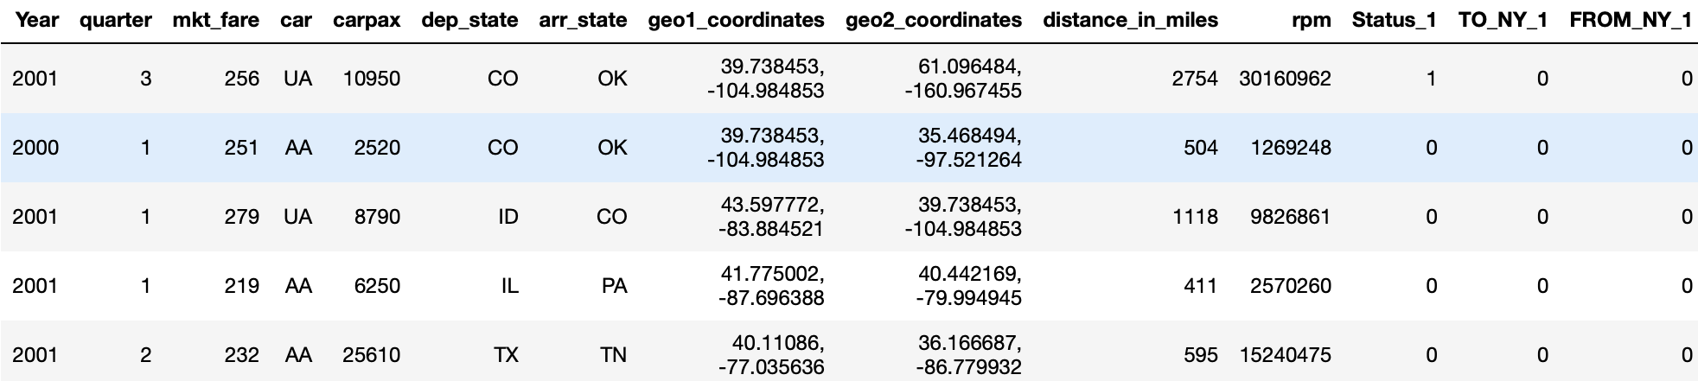
Datasets Overview
Consumer Airfare Data
Annual Reports
Source: US Department of Transportation.
Key Variables: Year, Quarter, Market Fare, Carrier Type, Cities, Passenger Volume, Geo-Coordinates
Purpose: RPM Calculations, OLS Modelling, Data Visualization
Source: Company Websites
Description: 10K Annual Reports
Dimensions: 100-300 pages of each report
Purpose: Sentiment Analysis, Textual Analysis, Data Visualization

Slide 9
02
Text Analysis

Slide 10
Text Analysis Process
Data Collection
Data Processing
Text Analysis
Data Visualization
10K annual reports of the top four airlines
Time range:
1999 - 2003
Convert to lowercase
Remove stopwords
Remove special characters
Observe frequency of keywords relevant to 9/11
Compare total word counts between airlines
Keywords: attacks, terrorist, terrorism, death, safety, security, hijacking
Visualize word frequency between United & American Airlines vs Southwest & Delta Airlines using bar charts
Create Word Clouds analyzing the text between the 2 groups

Slide 11
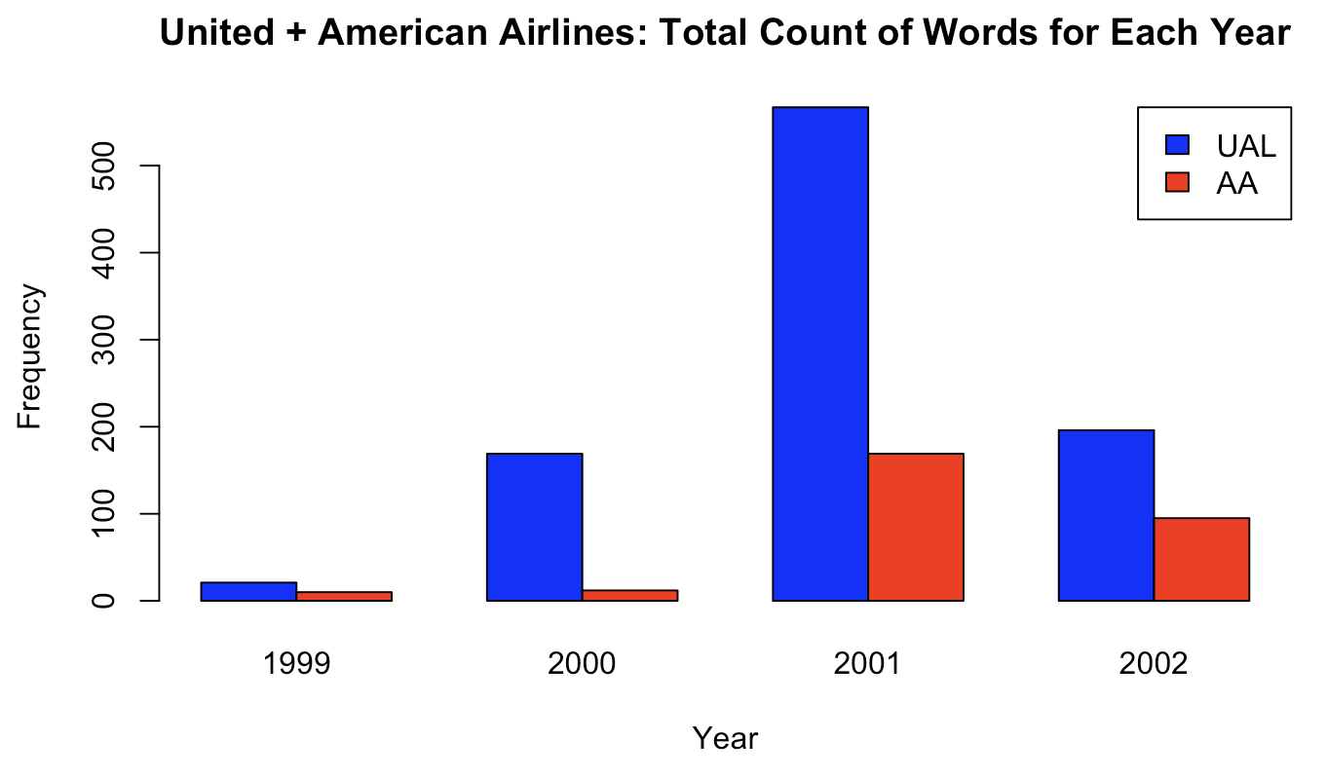
Comparison between Directly Affected Airlines
Keywords: attacks, terrorist, terrorism, death, safety, security, hijacking
Total word count: Frequency of each keyword added together per year
United Airlines had a significantly higher total word count than American, although they were both directly affected by the event

Slide 12
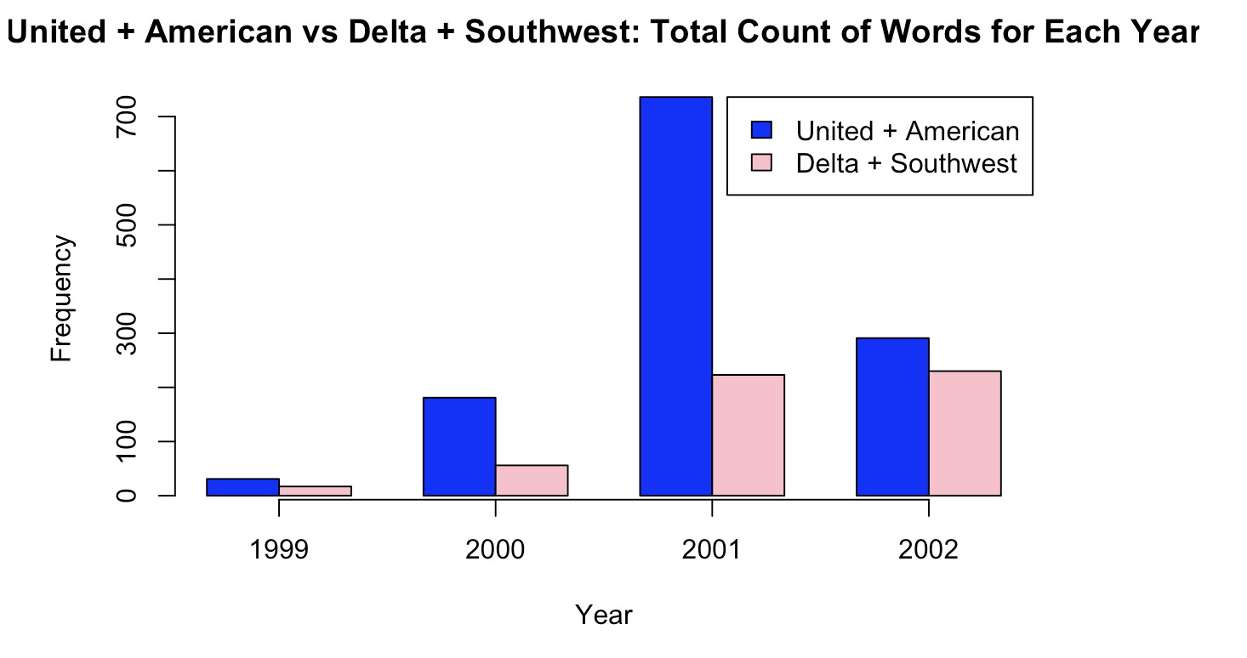
Comparison between Directly and Indirectly Affected Airlines
Keywords: attacks, terrorist, terrorism, death, safety, security, hijacking
Directly affected airlines =
United + American
Indirectly affected airlines =
Delta + Southwest
Airlines directly affected had a significantly greater total count of words after 9/11 compared to indirectly affected airlines
Notes:
We looked at them by words, not a huge difference. Had same patterns pre and post 9/11
So we decided to Sum all words, and compare it with the 2 airlines that were affected directly with the 2 that were not

Slide 13

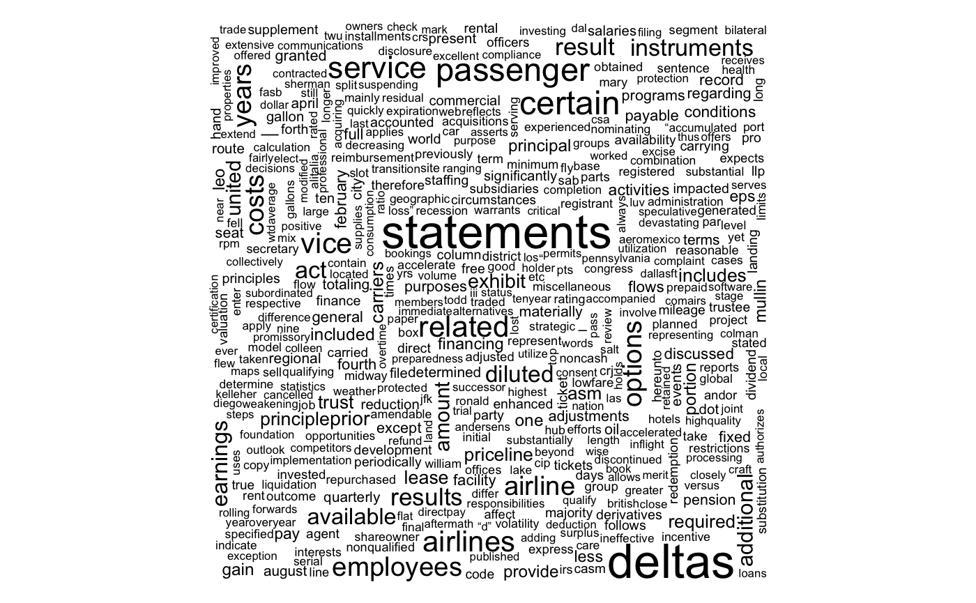
Text Comparison Between Two Groups
United + American
Delta + Southwest

Slide 14
03
Sentiment Analysis

Slide 15
Sentiment Analysis Process
Data Collection
Data Preprocessing
Sentiments
Analysis
Data Visualization
10K annual reports of the top four airlines
Time range: 2001 - 2003
Convert to lowercase
Remove stopwords
Remove special characters
Stemming
NRC sentiment dictionary
- Emotions
- Sentiments
Emotions distribution
Comparison between AA-UA and DAL-SW

Slide 16
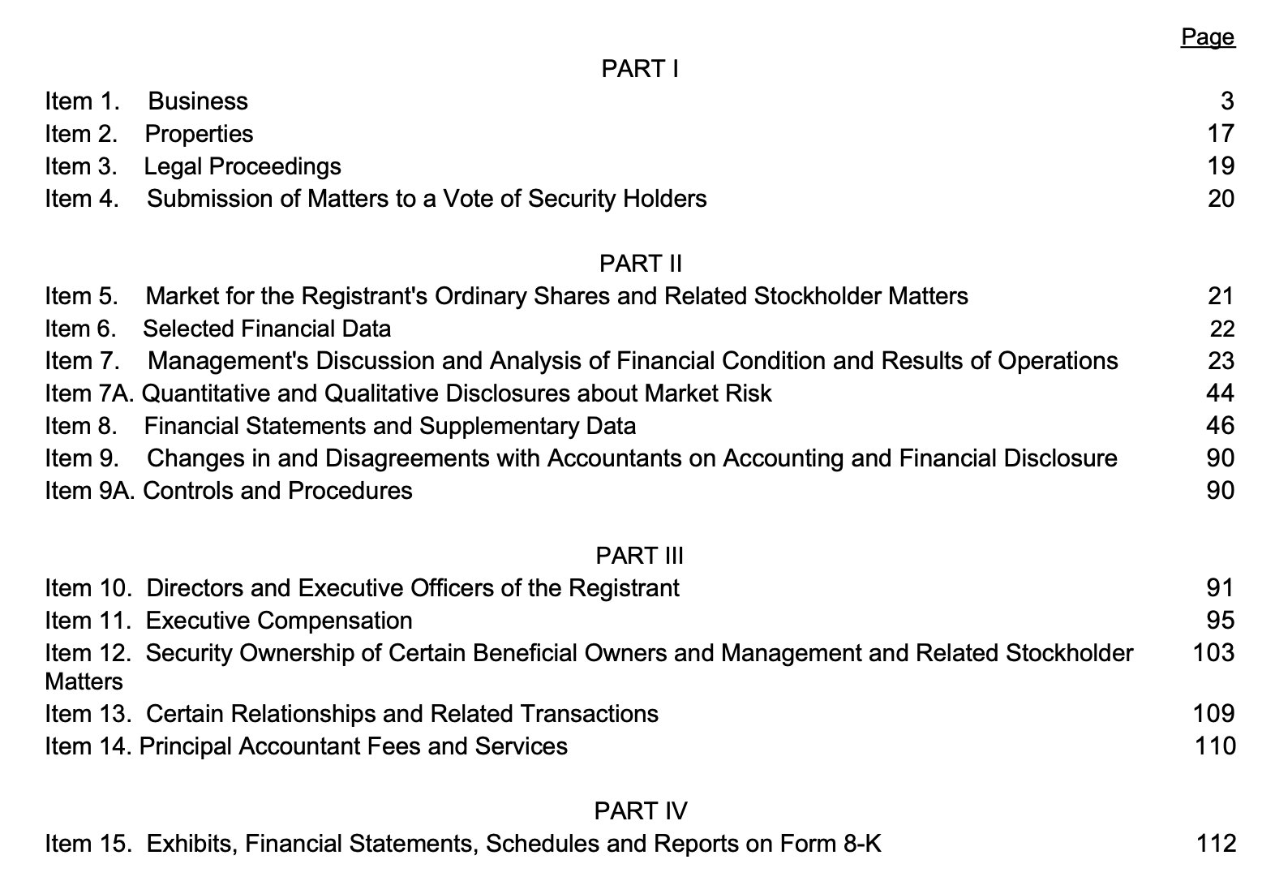
Sentiment Analysis
01
Annual Reports for the 4 Airlines
Target sections:
Item 7 - Management discussion and analysis
Item 1 - Business
Letter to Shareholders (if exists)
Rationale:
Item 7: an in-depth narrative explanation, from management’s perspective, of the financial results and condition of the company.
Item 1: an overview of the company's main operations, products, services,and structure.
Letter to Shareholders: a direct communication from the executives to the shareholders

Slide 17

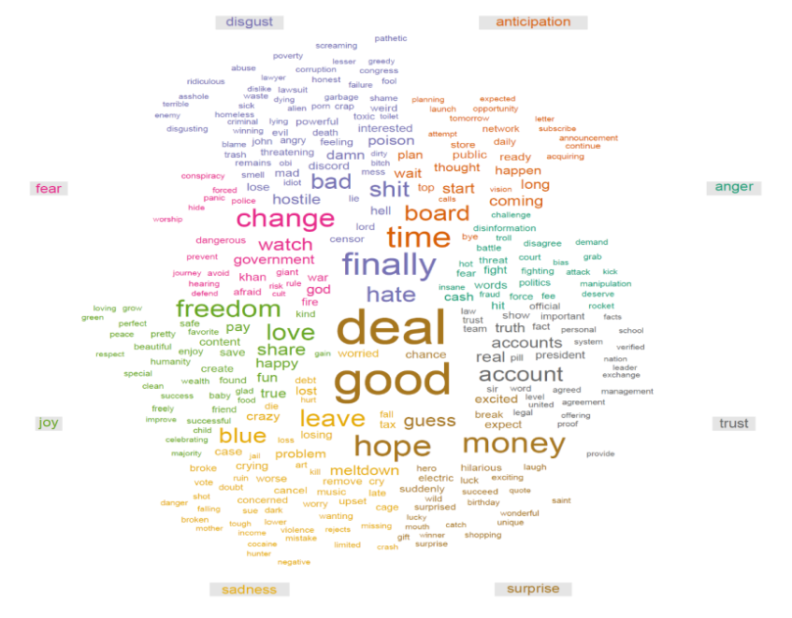
Sentiment Analysis
02
NRC sentiment dictionary
Emotions: anger, anticipation, disgust, fear, joy, sadness, surprise, trust
Sentiments: negative, positive
A single word can be tagged as expressing more than one emotion
Rationale:
More comprehensive in terms of the range of emotions
Ensures the complexity and multiplicity of emotional expressions in language
“Top 200 words in NRC emotion categories”

Slide 18
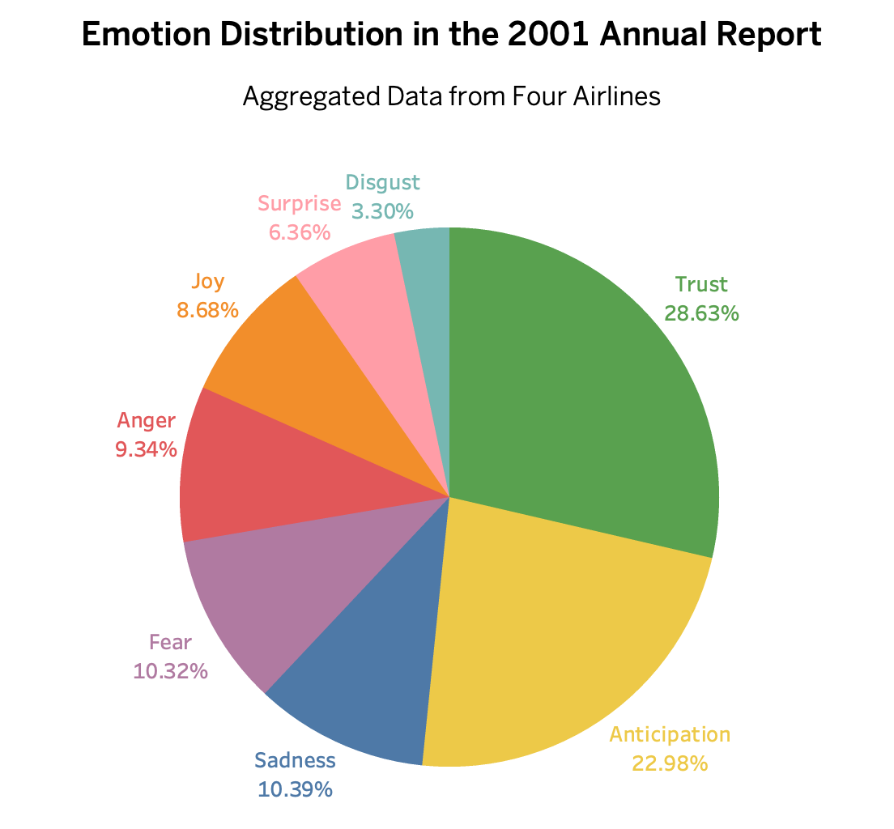
Visualization 1: Emotion Distribution
"Trust" and "Anticipation" are in the top two percentages among all airlines, which reflect the forward-looking and resilient attitude that the report aims to convey to preserve the company’s image.
Negative emotions like“Sadness”,“Fear”, and “Anger” generally have lower percentages, which indicate a more measured tone in the reports, even if discussing challenging topics.

Slide 19
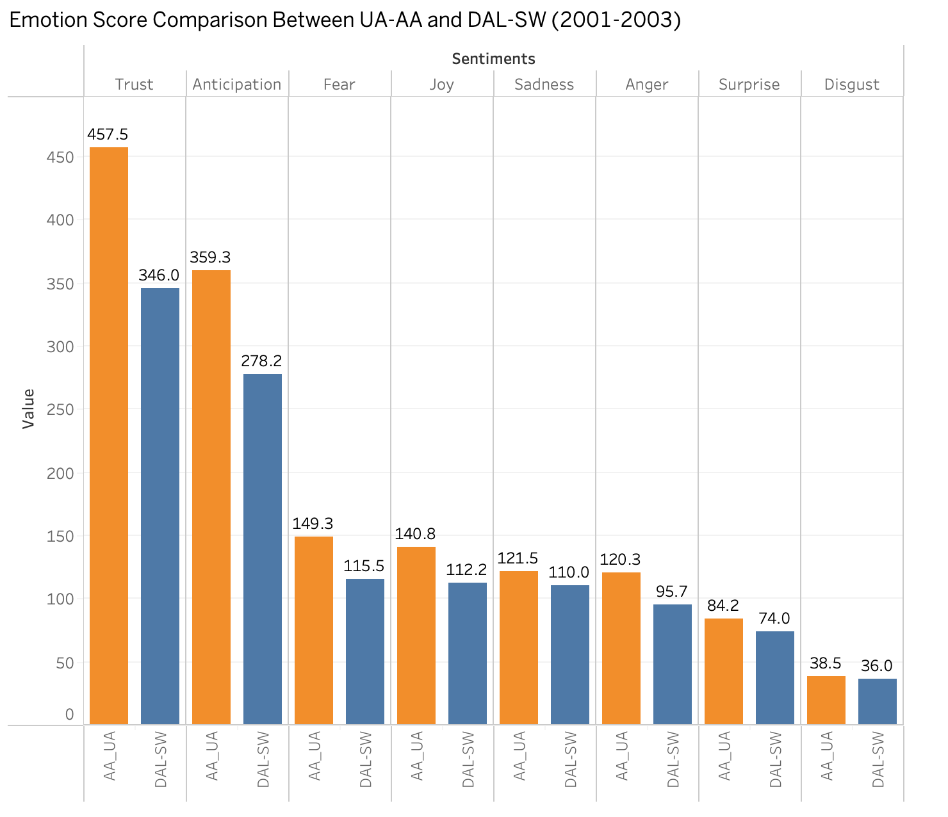
Visualization 2: Comparison between UA+AA and DAL+SW
United and American Airlines have higher average scores for all the emotions, possibly because they were the airlines directly affected by 9/11.
Delta and Southwest Airlines have lower average scores for all the emotions.

Slide 20
04
Exploratory Data Analysis

Slide 21
Exploratory Data Analysis- Methodology
Consumer Airfare Data
Filtering for UA-AA Flights
Focus on years before & after 9/11
NY_Based_Flight- if Departure/ Arrival State= NY (0/1)
Status- Pre/Post 9/11 (0/1)
Creating Dummy Variables
TO_NY- Arrival State= NY (0/1)
FROM_NY- Departure State= NY (0/1)
Calculating RPM using Geo Coordinates
Visualizing Data
RPM = Passenger Volume * Flight Distance

Slide 22
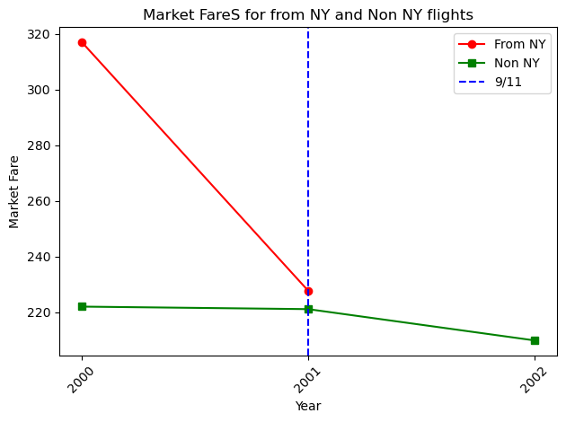
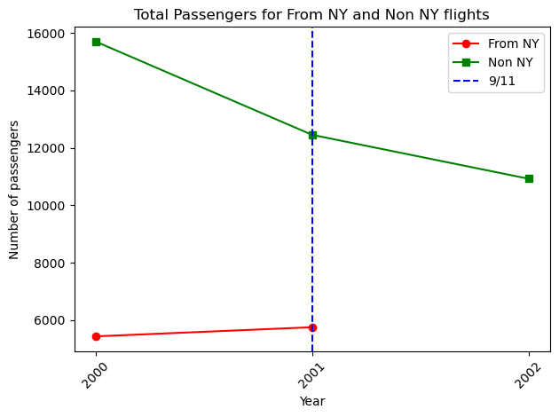
From NY Vs Non NY Cities
Market Fare drops dramatically from 2000 to 2001 for flights from NY and gradually reduces for Non-NY flights.
Passenger volume slightly increases for flights departing from NY after 9/11 and drops for other cities.
Data points were not available for flights travelling from NY between 2001 and 2002.

Slide 23
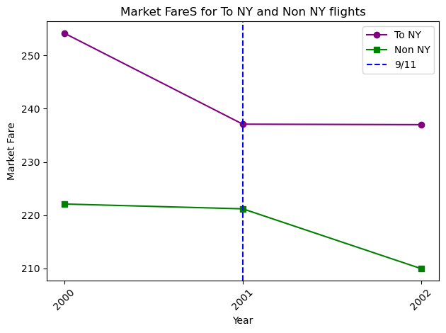
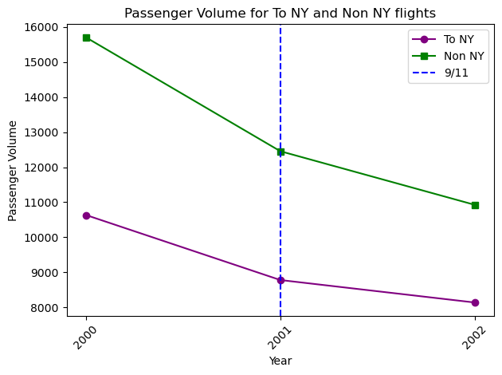
To NY Vs Non NY Cities
Market Fare remains consistent for flights flying to NY and dips for flights flying to other cities.
Passenger volume reduces after 9/11 for flights travelling to both NY and to other cities.

Slide 24
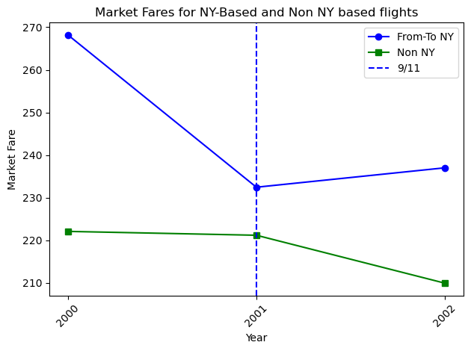
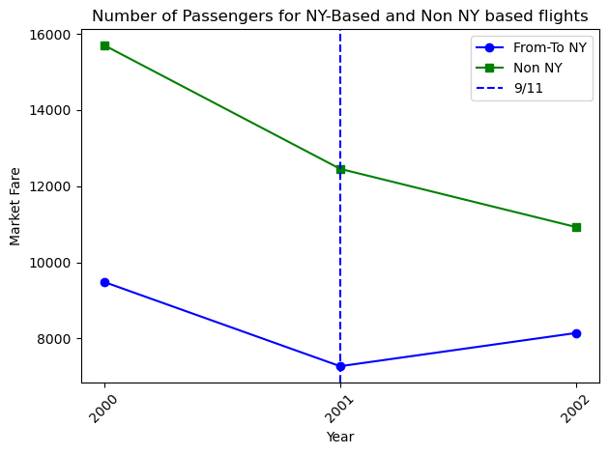
NY Based Vs Non-NY Based Flights
Market Fare faces a stark dip for NY Based Flights as compared to non-NY Based Flights between 2000 and 2001.
Passenger Volume drops for NY Based and non-NY Based flights but picks up after 9/11 for NY Based flights.

Slide 25
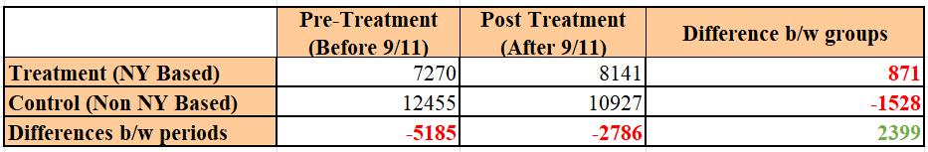
NY Based Vs Non-NY Based Flights- DiD Trend
Treatment Group: Flights flying to or from NY (where the 9/11 attack occurred)
Control Group: Flights flying in routes that don’t go through NY
It is observed that overall, passenger volume increased by 2,399 units after the 9/11 incident.
Since NY Based Vs Non-NY Based Passenger Volumes show parallel trends before the disaster, we can attribute this passenger volume increase to the 9/11 attacks.
This resonates with the sentiment analysis where people did not lose trust in the airlines.

Slide 26
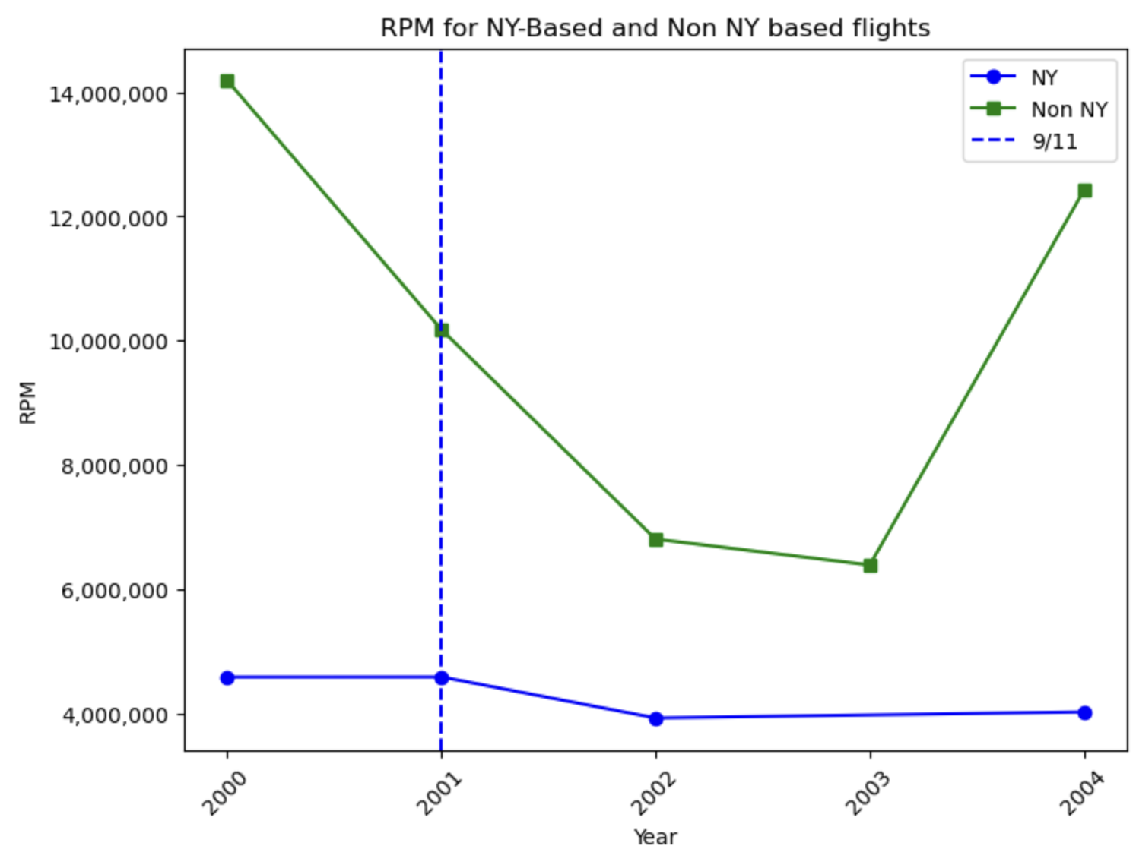
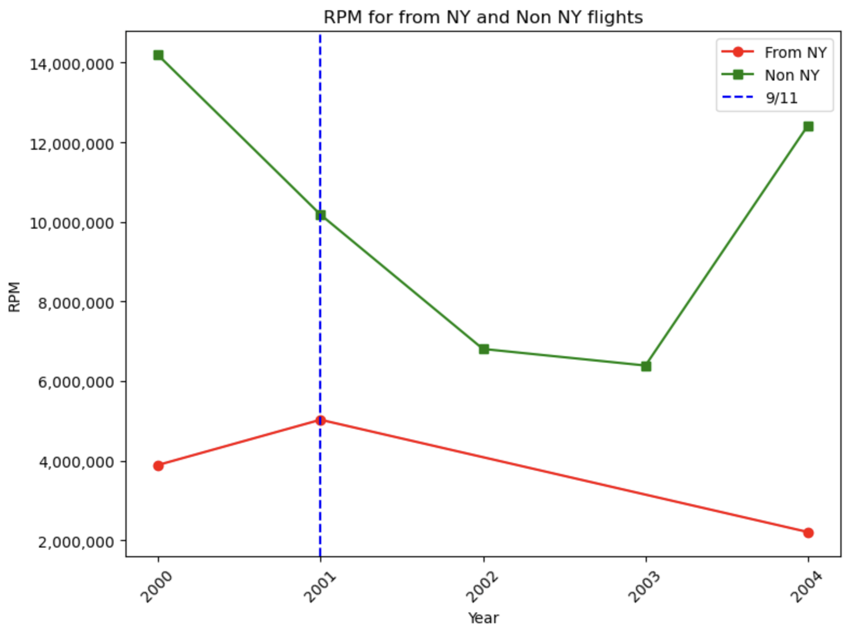
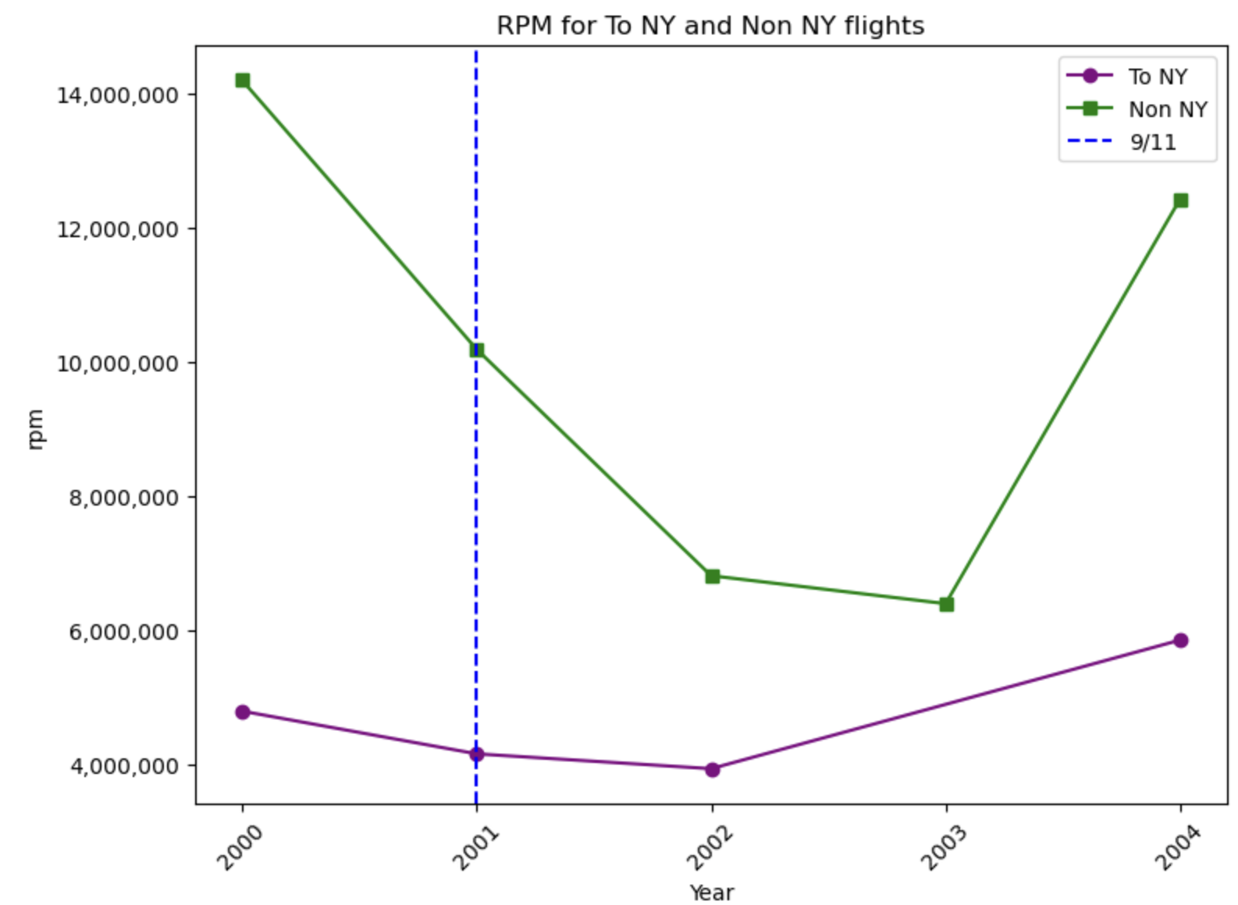
RPM Visualizations
NY and Non-NY based Flights
From NY and Non-NY Flights
To NY and Non-NY Flights
NY based - hasn’t reached its peak after 2001.
Non-NY based - steep decline after 2001 till 2003 but slowly recovers.
From NY - Steep decile after 2001 and never improved.
Non-NY - steep decline after 2001 till 2003 but slowly recovers.
To NY - gradually declines after 2001 but picks up in 2002.
Non-NY - steep decline after 2001 till 2003 but slowly recovers.

Slide 27
05
Regression Analysis

Slide 28
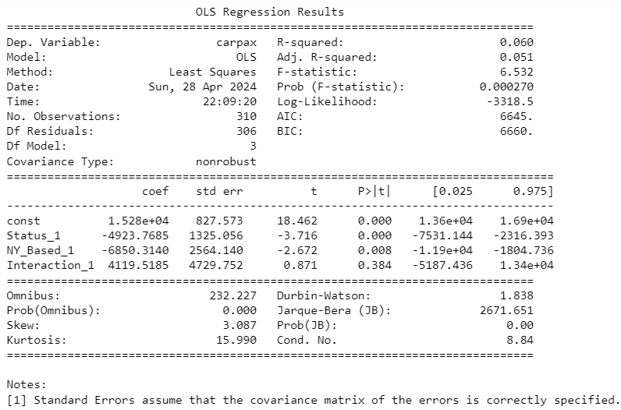
Passenger Volume against NY_Based, Status, Interaction Term
Dependent variable:
carpax - Passenger Volume
Independent Variable
Status_1- whether the period is pre/post 9/11
NY Based_1 - Whether the flight is operating on an NY Route
Interaction- Status_1 * NY_Based_1
Results:
If Status is post 9/11, passenger volume drops by 4,923 units.
If the Flight is operating to or from NY, passenger volume drops by 6,850 units.
The interaction term is not significant in this regression since the p-value is >0.05 .

Slide 29
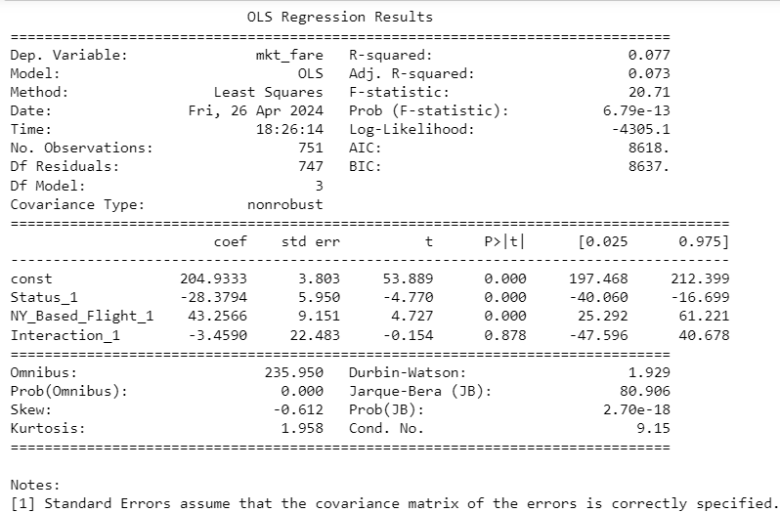
Market Fare against Status, NY_Based_Flight and Interaction
Dependent variable:
mkt_fare - Market Fare
Independent variables:
Status_1 - Post 9/11 flights dummy
NY_Based_Flight_1- Whether the flight is operating on an NY Route (dummy)
Interaction_1- Dummy variable that captures the interaction between Status_1 and NY_Based_Flight_1
Results:
All predictors except Interaction contribute significantly to market fare estimation
Market fare is negatively affected 9/11 Status but if the flight is headed towards or from NY, market fare increases

Slide 30
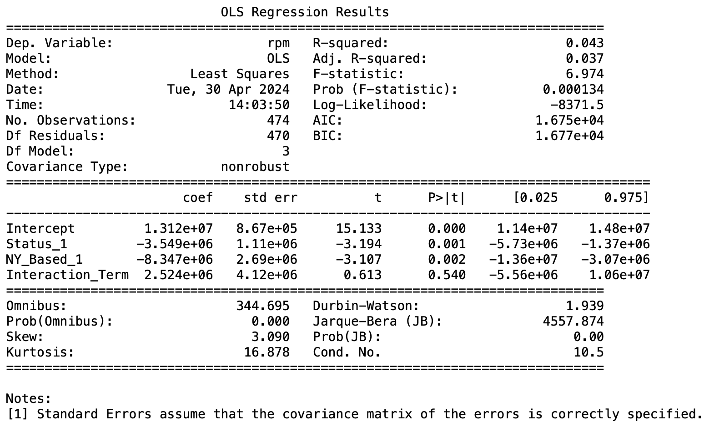
RPM against Status, NY_Based_Flight and Interaction
Dependent variable:
rpm - Revenue Per Mile
Independent variables:
Status_1 - Post 9/11 flights (dummy)
NY_Based_Flight_1- Whether the flight is operating on an NY Route (dummy)
Interaction_Term- Variable that captures the interaction between Status_1 and NY_Based_Flight_1 (dummy)
Results:
All predictors except Interaction are statistically significant in predicting the rpm.
RPM is negatively correlated with NY_based and flights post 9/11.
If it was a NY_based flight and if it was operated post 9/11 then the RPM was less.

Slide 31
06
Conclusion

Slide 32
Conclusion
Airline Resilience and Recovery
Passenger Demand and Behavior
All 4 airlines had a significant increase in keywords after 9/11.
Airlines that were directly related to 9/11 had a higher count of keywords.
Reflects importance that airlines place on addressing public concerns and ensuring communication transparency.
Prevalence of positive emotions over negative emotions, particularly in the directly affected airlines, who experienced a significant increase in trust and anticipation after 9/11.
Shows airlines’ strong forward-looking stance in adversity.
All dummy variables, including pre/post 9-11 status and NY-based flight routes, were significant predictors of market fares, RPM and passenger volume.
Post-9/11 saw a slight rise in market fares and passenger volumes for NY routes.
Indicates sustained consumer loyalty and demand despite the attacks.
Supports the notion that robust customer service enhances trust and loyalty.
Notes:
Reinforcing positive sentiment through transparent communication and robust customer service could enhance trust and loyalty, crucial for long-term recovery and stability.

Slide 33
THANKS
Any questions?

